Slide 1
CS 301 ALGORITHMS LONGEST CIRCUIT PROBLEM
Ali Arda Girgin (26993)
Elif Aydın (28061)
Kaan Atmaca (28239)
Kamil Atakan Çelikyürek (26896)

Slide 2
Outline
1. Problem Description - Basic Definition
2. Problem Description - Real Life Application
3. Algorithm Description & Implementation
4. Algorithm Analysis - Correctness
5. Algorithm Analysis - Time Complexity Analysis
6. An Initial Testing of Implementation of the Algorithm

Slide 3
Problem Description - Basic Definition
The basic definition of the problem is to find the length of the longest simple cycle in an undirected and unweighted graph with the given vertices and edges.

Slide 4
Problem Description - Real Life Application
Supply Chain Management:
Aims to cut excess cost and deliver the products to the consumer in an efficient way
The longest circuit problem algorithm to find a route which maximizes the number of customers visited
Constructing rail and road networks:
Make a rail network which is cyclic and maximizes the number of train stops included on the rail network

Slide 5
Algorithm Description & Implementation
There are only a few algorithms which have polynomial time complexity are known for the longest circuit problem for special classes of graphs.
As the algorithm for the longest circuit problem, we are going to use an algorithm that has a O(V!) time complexity.

Slide 6
Steps of the Algorithm - Step #1
Enumerate all vertices of the graph.
Form an array which has size of all vertices to store visit condition of all nodes.

Slide 7
Steps of the Algorithm - Step #2
Create an empty stack and push the initial vertex to the stack.
Create a list of stacks to save possible paths.

Slide 8
Steps of the Algorithm - Step #3
Apply LSC algorithm to find the longest path.

Slide 9
Steps of the Algorithm - Step #3
Steps of Our Algorithm - Step #3.1
Assign current vertex as the vertex in top of the stack.
Steps of Our Algorithm - Step #3.2
If current vertex is initial vertex and is visited, then return from function call.
Steps of Our Algorithm - Step #3.3
Mark the current vertex as visited.

Slide 10
Steps of the Algorithm - Step #3.4
For each of vertices that are adjacent to current vertex apply the following procedure.

Slide 11
Steps of the Algorithm - Step #3.4
Steps of Our Algorithm - Step #3.4.1
If adjacent vertex is either not visited or adjacent vertex is the start vertex; and not equal to predecessor of current vertex, then push this adjacent vertex to the top of stack.
Steps of Our Algorithm - Step #3.4.2
Recursively apply the LSC algorithm.
Steps of Our Algorithm - Step #3.4.3
After recursive operations are done, check the top of the stack, whether it is the initial vertex or not; if it is init vertex, save
the current state of the stack to the array of stacks
Steps of Our Algorithm - Step #3.4.4
Pop the top element of stack.

Slide 12
Steps of the Algorithm - Step #4
Compare the paths and find the path which has the most vertices.
There will be at least two paths that have the most vertices, finding one of them is sufficient.

Slide 13
Implementation of the algorithm
01. void LongestSimpleCircuit(int start, int last, vector<int> isVisited, const vector<vector<int>>
&adjacencyMatrix, vector<Stack<int>> &paths, Stack<int> currentStack)
02. {
03. int current = currentStack.getTop();
04. if (current == start && isVisited[current] == 1)
05. {
06. return;
07. }
08. isVisited[current] = 1;
09. for (int index = 0; index < (int)adjacencyMatrix[current].size(); index++)
10. {
11. if (adjacencyMatrix[current][index] == 1 && (isVisited[index] == 0 || index == start) &&
last != index)
12. {
13. currentStack.push(index);
14. LongestSimpleCircuit(start, current, isVisited, adjacencyMatrix, paths, currentStack);
15. if (currentStack.getTop() == start)
16. {
17. paths.push_back(currentStack);
18. }
19. currentStack.pop();
20. }
21. }
22. }
The algorithm in C++ language as follows:

Slide 14
Algorithm Analysis - Correctness
The algorithm that we discussed is not the optimal algorithm for the longest circuit problem, however, it finds the correct answer. Therefore, in the algorithm, we trade speed for correctness.

Slide 15

Algorithm Analysis - Time Complexity Analysis

Slide 16
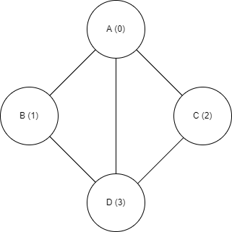
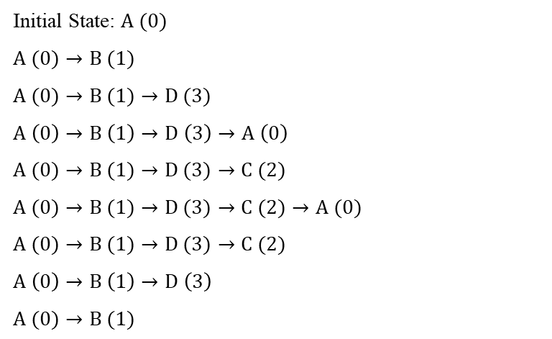
Initial Testing of the Algorithm Sample Case #1
Initial State: $A (0)$
$A (0)→B (1)$
$A (0)→B (1)→D (3)$
$A \left(0\right)→B \left(1\right)→D \left(3\right)→A \left(0\right)$
$A (0)→B (1)→D (3)→C (2)$
$A (0)→B (1)→D (3)→C (2)→A (0)$
$A (0)→B (1)→D (3)→C (2)$
$A \left(0\right)→B \left(1\right)→D \left(3\right)$
$A (0)→B (1)$

Slide 17
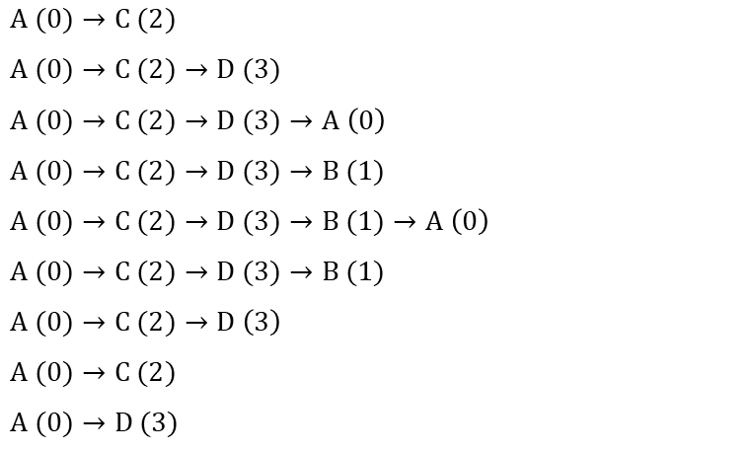
Initial Testing of the Algorithm Sample Case #1
$A (0)→C (2)$
$A (0)→C (2)→D (3)$
$A (0)→C (2)→D (3)→A \left(0\right)$
$A (0)→C (2)→D (3)→B (1)$
$A (0)→C (2)→D (3)→B (1)→A \left(0\right)$
$A (0)→C (2)→D (3)→B (1)$
$A (0)→C (2)→D \left(3\right)$
$A (0)→C (2)$
$A (0)→D (3)$

Slide 18
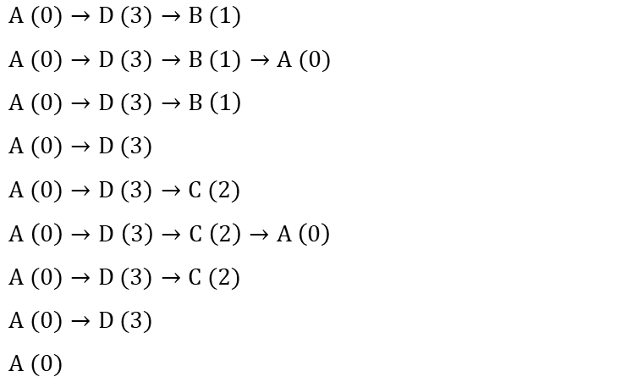
Initial Testing of the Algorithm Sample Case #1
$A (0)→D (3)→B (1)$
$A (0)→D (3)→B (1)→A (0)$
$A (0)→D (3)→B \left(1\right)$
$A (0)→D (3)$
$A (0)→D (3)→C (2)$
$A \left(0\right)→D \left(3\right)→C \left(2\right)→A \left(0\right)$
$A (0)→D (3)→C (2)$
$A (0)→D (3)$
$A (0)$

Slide 19
Initial Testing of the Algorithm Sample Case #1
Note that we can also start from the vertex D, as it has same degree with the vertex A.

Slide 20
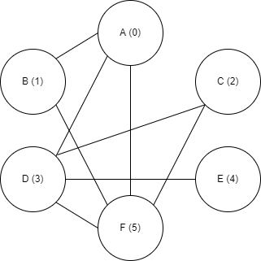
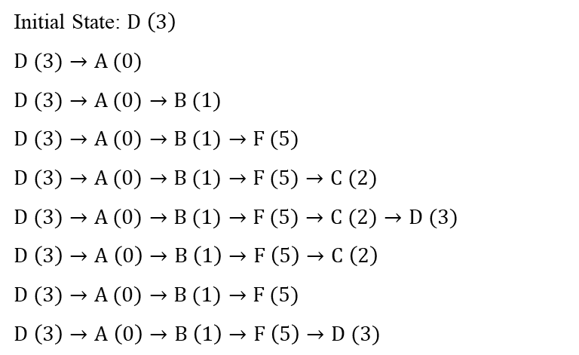
Initial Testing of the Algorithm Sample Case #2
Initial State: $D \left(3\right)$
$D (3)→A (0)$
$D (3)→A (0)→B (1)$
$D (3)→A (0)→B (1)→F (5)$
$D (3)→A (0)→B (1)→F (5)→C (2)$
$D (3)→A (0)→B (1)→F (5)→C (2)→D (3)$
$D \left(3\right)→A \left(0\right)→B \left(1\right)→F \left(5\right)→C \left(2\right)$
$D (3)→A (0)→B (1)→F (5)$
$D \left(3\right)→A \left(0\right)→B \left(1\right)→F \left(5\right)→D (3)$

Slide 21
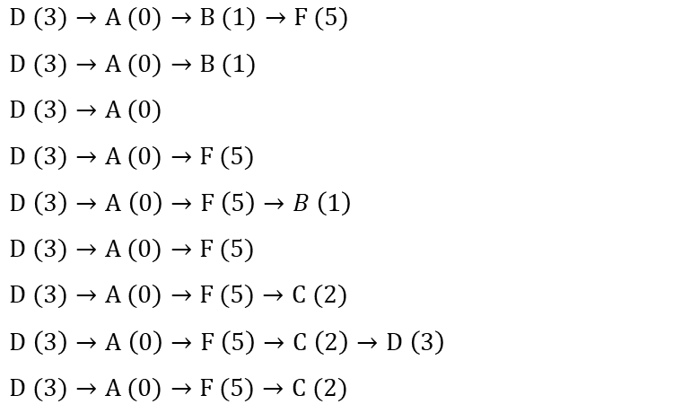
Initial Testing of the Algorithm Sample Case #2
$D (3)→A (0)→B (1)→F (5)$
$D (3)→A (0)→B (1)$
$D (3)→A (0)$
$D (3)→A (0)→F (5)$
$D \left(3\right)→A \left(0\right)→F \left(5\right)→B \left(1\right)$
$D (3)→A (0)→F (5)$
$D (3)→A (0)→F (5)→C (2)$
$D \left(3\right)→A \left(0\right)→F \left(5\right)→C \left(2\right)→D \left(3\right)$
$D (3)→A (0)→F (5)→C (2)$

Slide 22
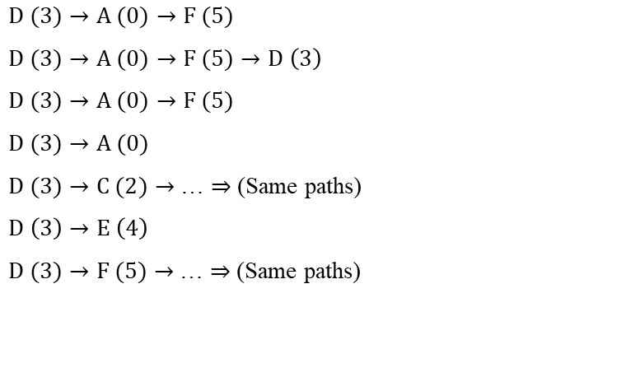
Initial Testing of the Algorithm Sample Case #2
$D (3)→A (0)→F (5)$
$D (3)→A (0)→F (5)→D \left(3\right)$
$D (3)→A (0)→F (5)$
$D (3)→A (0)$
$D (3)→C (2)→$ … $⇒$ (Same paths)
$D \left(3\right)→E \left(4\right)$
$D (3)→F (5)→$ … $⇒$ (Same paths)

Slide 23
Initial Testing of the Algorithm Sample Case #2
Note that we can also start from the vertex F, as it has same degree with the vertex D.

Slide 24
Thank you for listening!

